Slide 1
Equity & Ownership Basics
2024 Berger Entrepreneur Bootcamp

Slide 2
Business Entity Selection Basics
Entity Type* | Ownership & Governance | Liability Protection | Tax Treatment
Sole Proprietorship | Owner controls all decisions. | Unlimited Liability – Obligations of business entity treated as obligations of owners | Flow-through Taxation – Entity not taxed; owners allocated pro rata portion of annual profits, reported on personal income taxes.
General Partnership (2+ Owners) | Each partner may bind partnership subject to partnership agreement. | Unlimited Liability – Joint and several liability for all partnership obligations | Flow-through Taxation Distributions generally tax-free
Corporations (C Corporation Tax Treatment) | Board of directors (1+ director) ultimate governing authority, elected by shareholders (owners) Officers control day-to-day management | Limited Liability – Shareholders not liable for entity obligations beyond at-risk capital | Double Taxation - Entity subject to corporate income tax and Shareholders subject to tax on dividend income
Corporations (S Corporation Tax Treatment) | Governance, same as C-Corp Ownership Limitations – Maximum 100 shareholders; required US citizens/LPRs Single class of stock rule | Limited Liability | Flow-through Taxation Reasonable comp of shareholder-employees subject to income tax Distributions generally tax-free
Limited Liability Companies (LLCs) | Flexible governance; most states allow management by member(s) (owners) or manager(s), subject to operating agreement. | Limited Liability | Check-the box selection for Flow-through taxation (disregarded entity/partnership), S Corporation, or C Corporation
*Please note the above descriptions are based on general concepts common across multiple jurisdictions. Specifics for each entity type are governed by applicable state and tax law, and are not covered by this presentation.

Slide 3
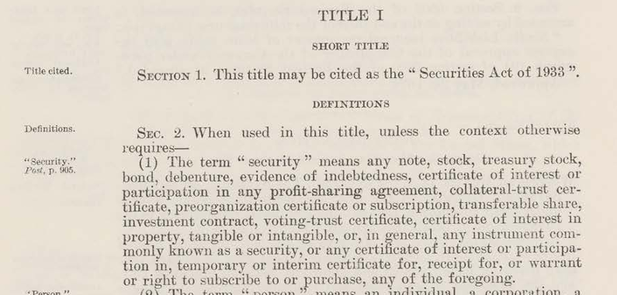
Securities Transactions – The Basics
Section 5, Securities Act of 1933
Section 5 of the Securities Act of 1933, as amended (Securities Act), requires all offers and sales of securities to be registered with the Securities and Exchange Commission (SEC) unless there is an available registration exemption.
What is a “Security”? - Section 2(1)
“any note, stock, treasury stock, security future, security-based swap, bond, . . . or, in general, any interest or instrument commonly known as a “security”, or any certificate of interest or participation in, temporary or interim certificate for, receipt for, guarantee of, or warrant or right to subscribe to or purchase, any of the foregoing.
Section 2(1) of the Securities Act of 1933, Pub. L. 86–70, § 12(a), codified at 15 U.S.C. Section 77b(a)(1)

Slide 4
Securities Transactions – The Basics, cont’d
Most common exemptions:
Section 4(a)(2) of the Securities Act, which exempts from registration transactions by an issuer not involving a public offering.
Rule 506 of Regulation D, which provides safe harbor exemptions under Section 4(a)(2) for private placements that meet specified objective standards.
Section 4(a)(2) Issuer Private Placements & Safe Harbors
Rule 504 (under Section 3(b)(1)).
Rule 506(b) (supplement to Section 4(a)(2)).
Rule 506(c) (supplement to Section 4(a)(2)).
Offering Features - Investor suitability, Limited number of investors, Prohibition on general solicitation and general advertising, Information requirement, Transfer restrictions on “Restricted Securities”, Investment intent, Integration with other offerings
Rule 10b-5 Anti-Fraud Rules – Private Civil Cause of Action & SEC Criminal Enforcement
“it shall be unlawful for any person . . . (a) [t]o employ any device, scheme, or artifice to defraud, (b) [t]o make any untrue statement of a material fact or to omit to state a material fact . . . or (c) to engage in any act, practice, or course of business which operates or would operate as a fraud or deceit upon any person, in connection with the purchase or sale of any security.”

Slide 5
Regulation D Requirements
 | Rule 504 | Rule 506(b) | Rule 506(c)
Maximum size of offering | $5 million (in aggregate with all securities sold under Section 3(b)(1) or in violation of Section 5(a) of the Securities Act) per year. | No limit on size of offering. | No limit on size of offering.
Issuers permitted to rely on this exemption | Non-reporting companies; non-investment companies (as defined in the Investment Company Act of 1940, as amended (ICA)), nor blank check companies. | Any issuer. It can be used by both reporting companies and non-reporting companies. | Any issuer. It can be used by both reporting companies and non-reporting companies.
"Bad actor" disqualification | Bad actor disqualification by reference to Rule 506 bad actor disqualification. | Certain Criminal Convictions (5-10 years old) Court Injunctions (5 years old) SEC Administrative Orders (5 years old) State Securities Regulator Orders Security Industry Bars, Suspensions, Expulsions | Same
Types of investors that can buy the securities | Any investor. No limits on number or sophistication of investors. | Unlimited accredited investors and up to 35 non-accredited investors (must be sophisticated investors). | Unlimited accredited investors.
Limitations on resale of securities? | Yes, subject to the exceptions provided by Rule 504(b)(1). | Yes. | Yes.
Form D filing? | Yes. | Yes. | Yes.
State law (blue sky) registration and qualification requirements pre-empted? | No. | Yes. | Yes.

Slide 6
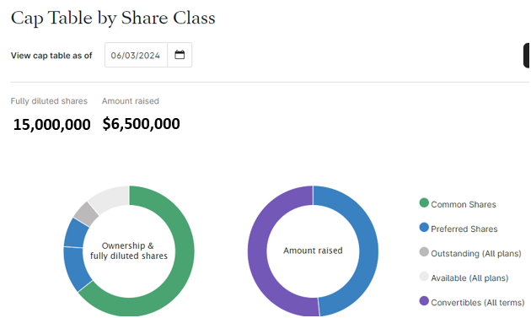
Basics of Corporate Equity
Common Stock
“Residual” class of owners; beneficially own corporate assets after obligations repaid
Elect directors, participate in shareholder voting on per-share basis
Founders issued shares at incorporation for nominal value
Preferred Stock
Negotiated financing by early-stage company investors
Minority ownership position based on enterprise value
Convert into common stock (conversion price, subject to adjustment)
Carry enhanced rights: liquidation preference, anti-dilution, special protective provisions, board appointment rights, preemptive rights, and others
Equity Incentive Shares
Defined pool of equity Issued subject to incentive “plan”
Equity often awarded as stock options, requires payment of exercise price.
Employees may receive “ISOs” (incentive stock options) up to $100k
Tax law requires exercise price not less than FMV of one share of common stock
May be subject time or milestone-based vesting and mandatory repurchase rights
Convertible Securities – Convertible Notes, SAFEs, KISSes, Warrants

Slide 7
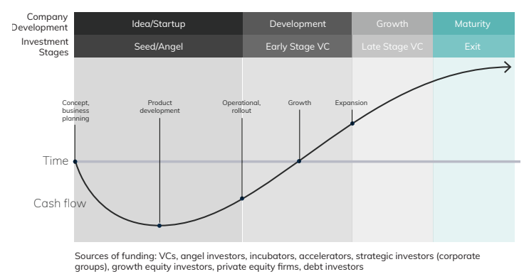
Firm Life Cycle and Financing
Other Forms of Financing
Bridge Financing
Venture debt – Traditional loan plus equity warrant coverage
Crowdfunding
Start-Up Accelerators – Funding, training and support for fixed duration, post-product phase
Start-Up Incubators and Venture Studios – Funding, training and support for indefinite time during product development.
Source: National Venture Capital Association, 2020 Yearbook

