Slide 1
Basics of Insurance
Placeholder for optional client logo
Essential Knowledge for Aspiring Entrepreneurs
October 31, 2024
Ryan Menocal, Commercial Insurance Advisor, Fort Lauderdale

Slide 2
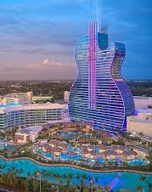
The house always wins.

Slide 3
“Insurance is a contract, represented by a policy, in which a policyholder receives financial protection or reimbursement against losses from an insurance company.”

Slide 4
Scare Tactics

Slide 5
Using Insurance to Create Predictability

Slide 6
Types of Insurance Coverages
General Liability Property Insurance Auto Workers' Compensation Insurance
Cyber
Errors & Omissions
Directors & Officers
Employment Practices Liability

Slide 7
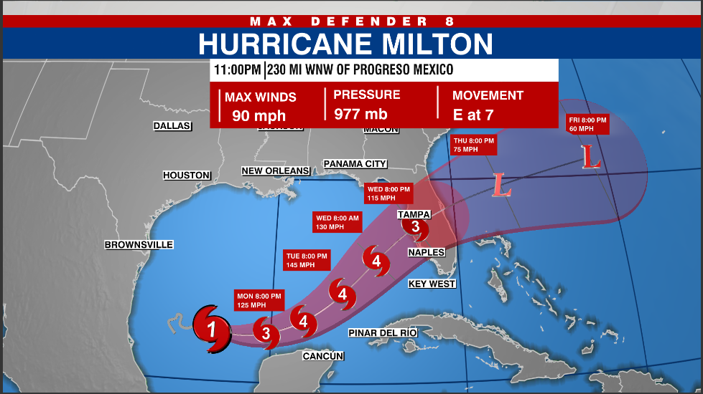
Assessing your Risk Profile
How do you know which policies to buy?
Consult with an Insurance Professional
Risk tolerance study
Contractual Obligations
Lease Client/Vendor Requirements
Legal Requirements
Raising Capital
Series A

Slide 8
General Liability Insurance
Quintessential Insurance Coverage
Premises Liability
Products/Completed Operations
Bodily Injury
Property Damage
Personal and Advertising Injury
Defamation, Slander, Copyright Infringement, or other non-physical injuries

Slide 9
Property Insurance
Building
Contents
Equipment, Furniture and Inventory inside building
Business Interruption
Lost income due to covered event that disrupts operations
Flood is typically excluded

Slide 10
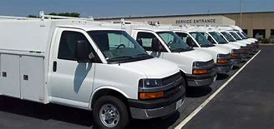
Auto
BI or PD caused to others
Collision Coverage
Comprehensive Coverage
Hired Non-Owned Auto
If you don’t own

Slide 11
Workers' Compensation Insurance
Mandatory in most states if > 4 employees Covers job-related employee injuries
Pays for medical costs, missed work, and other injury-related expenses Generally the sole-remedy for employees

Slide 12
Cyber
Data Breach Coverage
Notification costs, other legal fees
Network Security Liability
Hacking, Malware, etc.
Business Interruption
Lost income due to a cyber event
Access to confidential information?
Essential online systems

Slide 13
Errors & Omissions
“I have CGL for this”
Professional Liability
Negligence in services provided
Differs by business type
Medical Malpractice
Law
Financial Services
Tech

Slide 14
Directors and Officers
Covers Ds and Os if sued from actions while managing company
Mismanagement of Funds
Misleading Information
Consider once raising capital

Slide 15
Employment Practices Liability
Covers employment-related claims
Discrimination
Wrongful Termination
Harassment
Defense costs inside/outside limits

Slide 16
Building a Risk Profile
Bob’s Tech Company
Supply Chain Platform
20 employees
Office in Ft. Lauderdale
$5 Million Revenue
Coverages Purchased
General Liability
Workers’ Compensation
Cyber
Tech E&O

Slide 17
Building a Risk Profile
Bob’s Tech Company
General Liability
Lease requires $2M GL
Workers’ Compensation
More than 4 employees
Cyber
Tech E&O
Product-related failure
EPLI?
D&O?
Auto?
Personal Property?

Slide 18
Questions?

Slide 19
This document is not intended to be taken as advice regarding any individual situation and should not be relied upon as such. Marsh & McLennan Agency LLC shall have no obligation to update this publication and shall have no liability to you or any other party arising out of this publication or any matter contained herein. Any statements concerning actuarial, tax, accounting or legal matters are based solely on our experience as consultants and are not to be relied upon as actuarial, accounting, tax or legal advice, for which you should consult your own professional advisors. Any modeling analytics or projections are subject to inherent uncertainty and the analysis could be materially affected if any underlying assumptions, conditions, information or factors are inaccurate or incomplete or should change. d/b/a in California as Marsh & McLennan Insurance Agency LLC; CA Insurance Lic: 0H18131. MarshMMA.com

