Slide 1
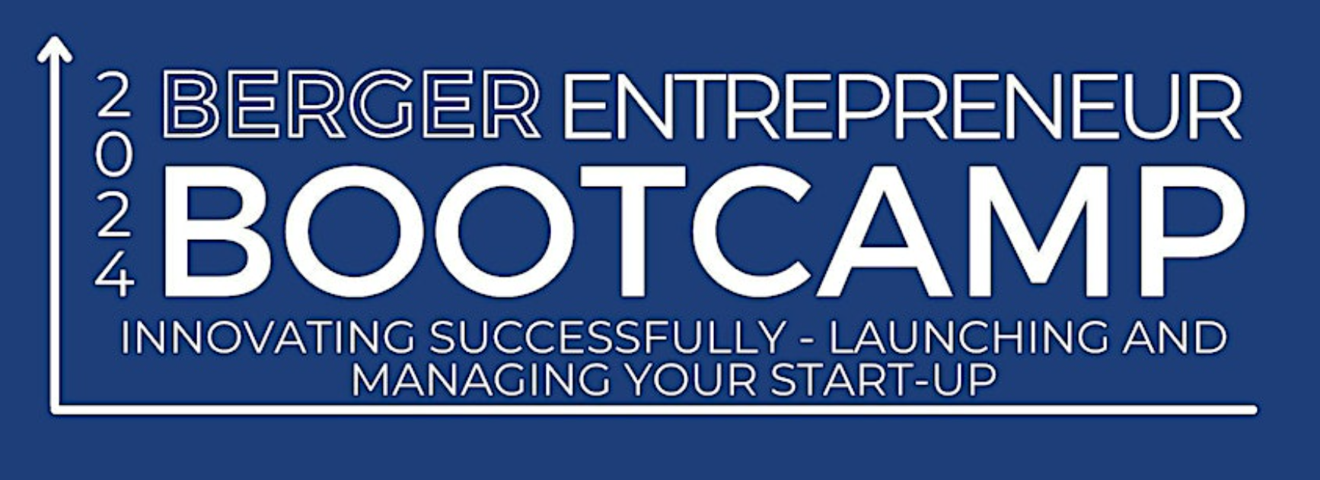
Copyright, Websites, and Materials
Paul Bianco
Fleit Intellectual Property Law
Kelly Ann desRosiers
The Lomnitzer Law Firm, P.A.
Veronika Balbuzanova
Johnson Dalal

Slide 2
Intellectual Property Fundamentals
Copyrights
What comes to mind?
Can you name some famous copyrights?
You pay a developer to create your website.
Is the website copyrightable?
If so, do you own the copyright to the website?

Slide 3
What is a Copyrightable Work?
Rights arise automatically upon creation of work.
Protects original works of authorship fixed in a tangible medium, including:
Books and other literary works
Paintings, photographs and graphic works
Music and recordings
Dramatic and choreographic works
Motion pictures/audiovisual works
Computer software/programs
User interfaces and website pages
©

Slide 4
Idea/Expression Dichotomy
Copyright protection does not extend to “any idea, procedure, process, system, method of operation, concept, principle, or discovery, regardless of the form in which it is described, explained, illustrated, or embodied…”
Compare copyrights to patent rights, which are generally broader in scope.
Federal copyright registration is not necessary until a lawsuit is filed.

Slide 5
Common Copyright Issues for Start-Ups
I can use anything I find on the Internet, Right?
NO!
Unlawful use of photos “downloaded” from websites or social media can lead to costly issues for start-ups but can easily be avoided.
I got a letter saying I “infringed” someone’s copyright – I can ignore it right?
NO!
While a lot of these letters may be baseless, they should not be ignored. Contact an attorney to discuss the letter and its accusations. The cost of an attorney will likely be far less than the costs of ignoring the letter.
As long as I put the owner’s name on it, it’s not copyright infringement, right?
NO!
If you do not have express consent to utilize the photo –you cannot use it. This is often referred to as licensing.
Can I just use AI to create my content and claim copyright ownership?
NO!
Artificial intelligence cannot be an author of a work and the act of merely “pushing a button” or inputting the request into an AI system does NOT vest any type of copyright ownership.

Slide 6
Authorship
The “author” of the work owns the copyright.
Who is the “author”?
The person(s) who created the work; or
If the work falls within the legal definition of a “work made for hire”, then it is the employer or other person for whom the work was prepared.

Slide 7
Work Made for Hire or Independent Contractor
I hired someone to create a work for me so I own it, right?
NO!
During start-up phase not a lot of “full-time employees” so start-ups utilize independent contractors or websites like Fiverr to assist in building websites/content for a low cost.
Work For Hire agreements require specific language in order to be upheld as a work-for-hire
Requisite Language of a work-for-hire agreement:
Agreements should expressly state that works created by independent contractors are works made for hire, where applicable
Agreements should also provide for an assignment of any and all IP rights in the work in case the type of work created does not fall within the statutory definition of a specially ordered or commissioned work
Many works do not fall under the statutory definition of specially ordered or commissioned work which is why the inclusion of an assignment of rights is vital

Slide 8
Exclusive Rights
The copyright owner has the exclusive rights to:
Reproduce the work in any form
Prepare derivative works
Distribute copies
Publicly perform
Publicly display
Transmit
Each right above may be licensed separately

Slide 9
Notice and Registration
Copyright notice may be given: ©, year, owner
If notice is used, no weight will be given to a defense based on innocent infringement in mitigation of actual or statutory damages.
It is not a requirement to include the notice, so just because its not attached to a work does not mean that work is not protected by copyright laws
Registration is permissive, but no infringement action may be commenced until copyright is registered.
Also, no statutory damages or attorney’s fees are available for infringement commenced after first publication of the work, unless registration is made within three months of first publication.

Slide 10
Copyright - Duration
Currently, copyright subsists from creation of work and endures for the author’s life plus 70 years
Works made for hire:
Term is 95 years from publication or 120 years from creation, whichever expires first.

Slide 11
Copyright Infringement
Infringement is the violation of any of the exclusive rights
Remedies
Injunctive relief
Impounding and disposition of infringing works and means for reproducing them
Actual damages and additional profits of the infringer, or
Statutory damages
$750 - $30,000 per work
Count can increase to $150,000 or reduce to $200
Cost and attorney’s fees
Criminal penalties – fine, forfeiture and destruction, imprisonment

Slide 12
Copyright – Fair Use
Fair use of a copyrighted work, including by reproduction of copies, for purposes of criticism, comment, news reporting, teaching, scholarship or research is not infringement.
Factors to be considered in determining fair use include:
Purpose and character of the use, including whether it is of commercial use or for non-profit educational purposes,
The nature of the copyrighted work;
The amount and substantiality of the portion used in relation to the copyrighted work as a whole; and
The effect of the use on the potential market for a value of the copyrighted work.

Slide 13
Timeliness of a Claim
Statute of Limitations for copyright infringement claims is 3 years. 17 U. S. C. §507(b) (noting that plaintiff must file suit “within three years after the claim accrued”).
There is a Circuit split on when exactly a claim “accrues”.
Under one interpretation, a copyright claim “accrue[s]” when “an infringing act occurs.”
Under another interpretation (also referred to as “the discovery rule”), a claim accrues when “the plaintiff discovers, or with due diligence should have discovered,” the infringing act.
Depending on the court and jurisdiction you are in, your time limits for bringing a copyright infringement claim may actually differ.
The Eleventh Circuit has adopted the discovery rule, meaning that a diligent plaintiff can raise claims about even very old infringements if he discovered them within the three years prior to suit.

Slide 14
Limits on Damages
Warner Chappell Music, Inc. v. Nealy, 601 U.S. 366 (2024).
Acknowledged the nuance in the law between time limits on asserting a claim and time limits on a plaintiff’s damages.
Issue: Whether a plaintiff with a timely claim under the discovery rule can get damages going back more than three years.
Ruling: Yes. “Nealy is in a different situation. He has invoked the discovery rule to bring claims for infringing acts occurring more than three years before he filed suit. And as we have explained, we took this case on the assumption that such claims may be timely under the Act’s limitations provision. If Nealy’s claims are thus timely, he may obtain damages for them. The Copyright Act contains no separate time-based limit on monetary recovery.”
How does this affect your prospective copyright infringement claim (or defense of an infringement claim brought against you)?

Slide 15
DMCA NOTICES
I received a DMCA notice, I do not have to do anything – right?
NO!
DMCA takedown notices should not ever be ignored. Failure to respond can lead to significant legal action
Steps to take:
Contact an attorney (optional but recommended)
Assess the claim – review the notice to determine what is at issue and who is making the claim.
Confirm it is a legitimate claim – is the copyright holder (or their rightful agent) filing this claim.
Remove the content (if applicable)
If you believe the DMCA claim is invalid and you have all of the proper rights you may consider a counter-claim
Contact the claimant – depending on the situation reach out to the copyright holder either to confirm removal or clarify why there is no infringement.

Slide 16
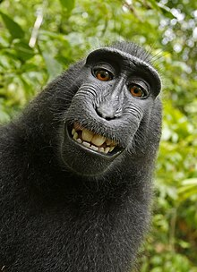
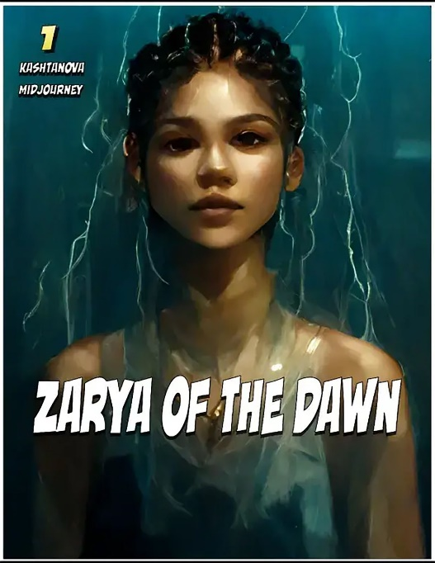
Copyright – Current Issues
Monkey Selfie- animals have
no legal authority to hold copyright claims
AI Generated Content- “Double Whammy”
No Copyright protection
Potential Liability for infringement
Indemnification

