Slide 1
Trademarks, Publicity Rights, and Endorsements Rules
Neda Lajevardi
Partner, Lott & Fischer
Nicholas Spatola
Founder, Origins Law
Adjunct Professor, NSU

Slide 2
Trademarks

Slide 3
What is a Trademark?
A trademark is any word, name, symbol, or device, or any combination thereof used to identify the source of goods or services and to distinguish the goods or services from those manufactured or sold by others.
®

Slide 4
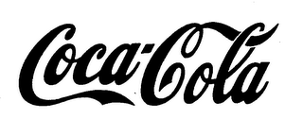
What is a Trademark?
Trademarks can be words (standard character or stylized):
COCA-COLA
Trademarks can be designs:
Trademarks can be colors or sounds:
Pink for insulation
NBC chimes
Trade Dress
Image and overall appearance of a product or its packaging

Slide 5
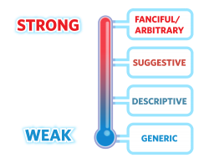
What is a Trademark?
Function of a Trademark
Identify and distinguish the goods of the owner from competing goods in the marketplace.
Guarantee a consistent level of quality.
A trademark represents the goodwill and reputation of a company.
Strong trademarks vs. Weak trademarks

Slide 6
Trademark’s Role in Branding
The Dictionary of Brand defines brand as “a person’s perception of a product, service, experience, or organization.”
Trademarks help construct brands.
They are among the most important and valuable assets of a business.
Trademarks can allow a business to build public goodwill and brand reputation in the goods or services it sells.

Slide 7
You’ve Chosen a Trademark, Now What?
Searching and clearing a mark
Legal and business risks
Enforcement
Securing domain names and social media accounts

Slide 8
Acquiring Rights in Trademarks
Rights accrue through use of the mark:
Once a mark is used, consumers begin to associate the mark with a specific product or service.
The mark becomes a symbol of the company’s reputation.
This is a U.S. concept – most other countries recognize trademark rights only on the basis of formal registration.
Rights last as long as use of mark continues.
Consider benefits of federal registration – proof of nationwide protection, federal jurisdiction, litigation advantages.
™ and ® symbols.

Slide 9
Term and Maintenance
Trademark registration term is 10 years from issuance.
Must file affidavit of continuing use between years five and six.
Can request incontestability to remove some attacks.
Must file for renewal and show continued use between years 9 and 10.

Slide 10
Remedies
Providing Notice of Registration - ® - Allows money damages for infringement:
Unless proof the infringer had actual notice of registration,
No ® = No claim for lost profits
No ® = No money damages
Infringement is:
The unauthorized use of a trademark on or in connection with goods and/or services in a manner that is likely to cause confusion, deception, or mistake about the source of the goods and/or services.
43(a) – false designation of origin, false description
Federal unfair competition law

Slide 11
Remedies
(continued)
Relief
Injunctions to prevent infringement
Seize and destroy infringing articles
Recover (1) defendant’s profits, (2) damages sustained by plaintiff, (3) costs of action
Court can multiply damages 3x
Court may award attorney’s fees in exceptional cases

Slide 12
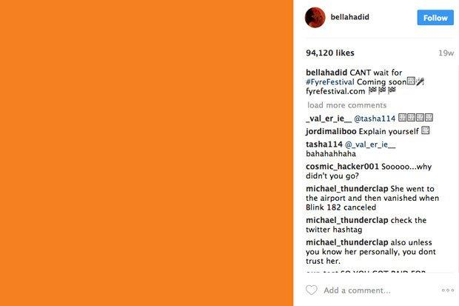
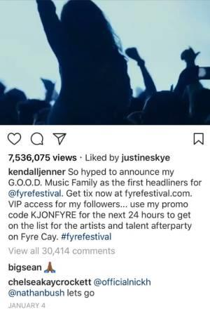
Endorsements, Testimonials, and Reviews
Truth in advertising is important in all media, whether they have been around for decades (like television and magazines) or are relatively new (like blogs and social media).

Slide 13
Introduction to Endorsement Rules
Main Points:
Definition: Endorsement rules, primarily under FTC guidelines, regulate how brand relationships must be disclosed.
Importance: Transparency is key to avoiding misleading consumers. Consumers need to know when someone promoting a product is compensated.
Material Connections: Any paid endorsements or “material connections” must be disclosed to the public.

Slide 14
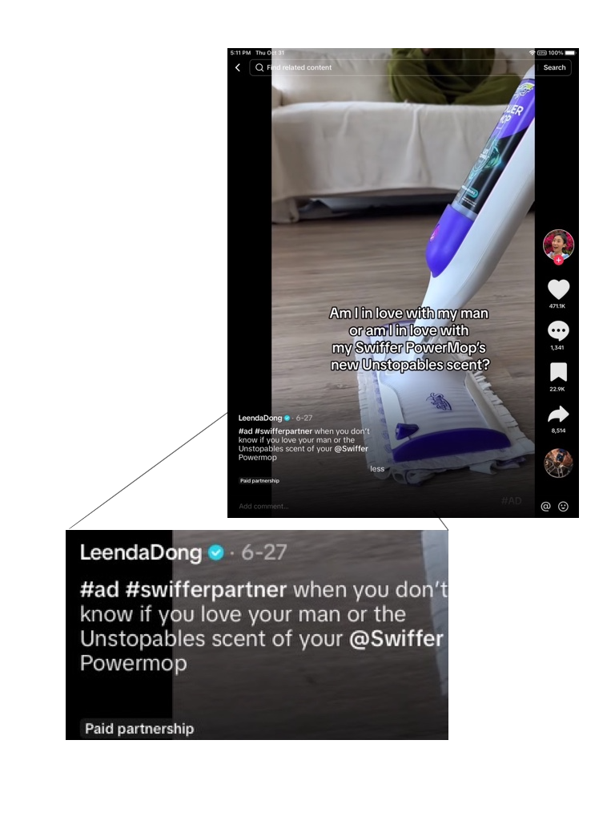
FTC Guidelines on Endorsements
Disclosure Requirements:
Clear and conspicuous disclosure required on any platform.
Material Connection: This includes payment, free products, discounts, or benefits.
Placement of Disclosure: Disclosures should be at the start of posts, not buried in hashtags or at the end.

Slide 15
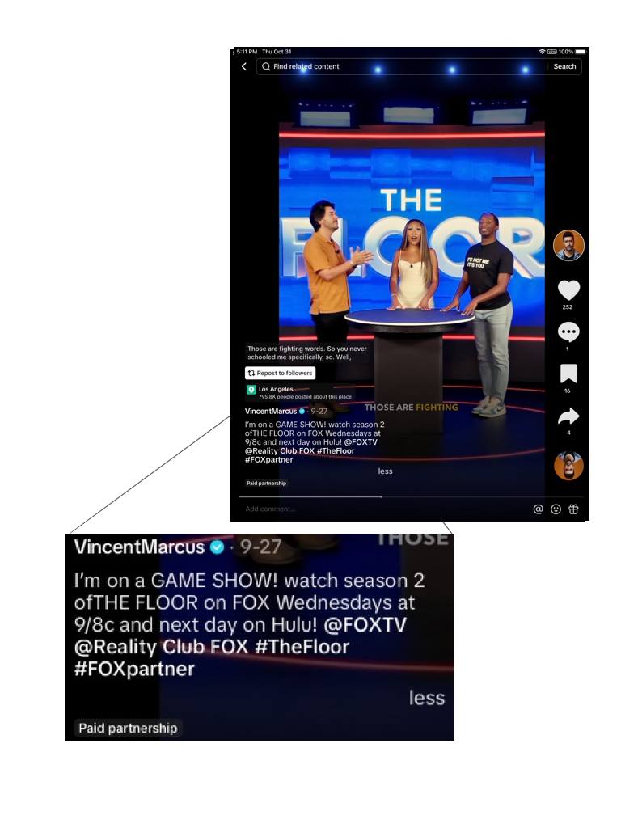
FTC Guidelines on Endorsements

Slide 16
Introduction to Endorsement Rules
Employee Endorsements: If employees endorse products publicly, they should disclose any material connections.
Expert Endorsements:
Representing endorser is an expert - qualifications must in fact give the endorser the expertise that he or she is represented as possessing with respect to the endorsement.
Endorsement must be supported by actual expertise regardless of opinion or personal taste.

Slide 17
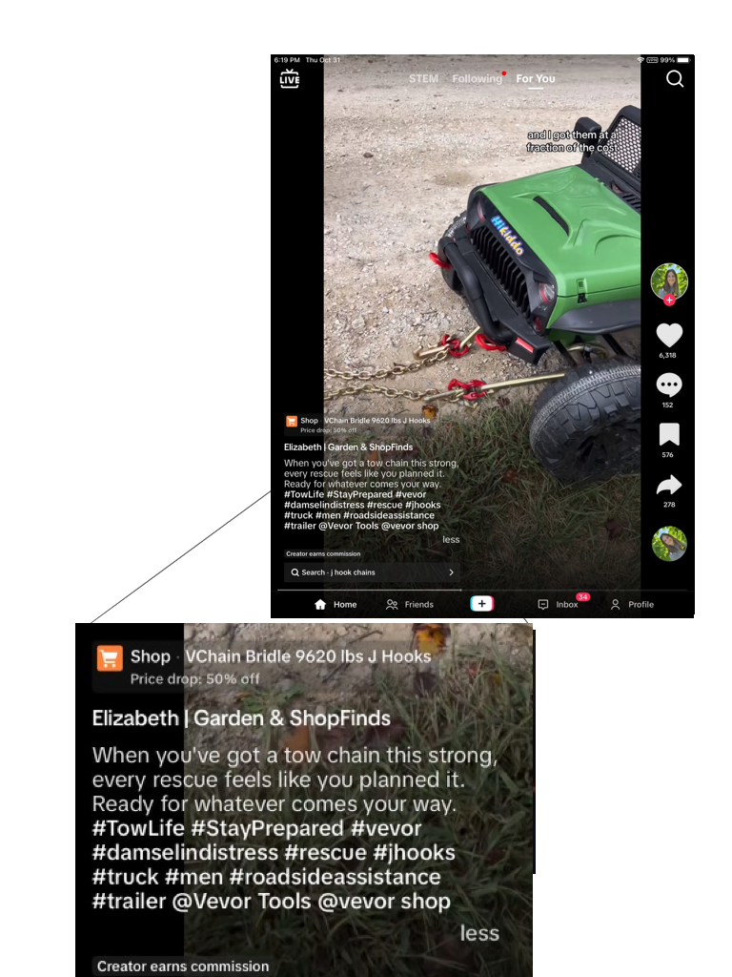
Introduction to Endorsement Rules
Disclosure of Material Connections:
When a connection exists between the endorser and the seller of the advertised product that might materially affect the weight or credibility of the endorsement, such connection must be fully disclosed.
Material Connections Defined:
Payment, free products, discounts, or other benefits count as material connections that require disclosure.
Disclosures must be clear and conspicuous so consumers understand the relationship.

Slide 18
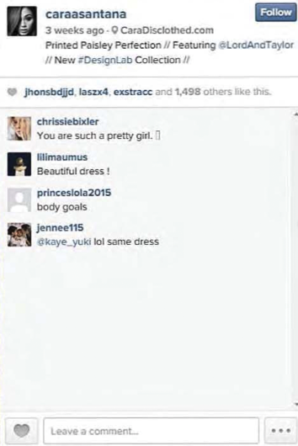
Florida-Specific Insights on Endorsement Compliance
Florida Deceptive and Unfair Trade Practices Act (FDUTPA):
Florida aligns with FTC guidelines under FDUTPA, which penalizes deceptive practices.
Influencer and Brand Liability: Both brands and influencers can be held liable under Florida’s consumer protection laws if endorsements are deceptive.
Example – Lord & Taylor Case: Lord & Taylor was fined for failing to require influencers to disclose that their posts were sponsored.

Slide 19
Endorsement Considerations
General Considerations:
Endorsements must reflect the honest opinions, findings, beliefs, or experience of the endorser.
The endorsement message doesn’t need to be the exact wording, but may not be presented out of context.
Use by endorser must have been a bona fide at the time the endorsement was given.
Advertisers are subject to liability for false or unsubstantiated statements.

Slide 20
Best Practices for Complying with Endorsement Rules
Clear Contract Terms: Include disclosure terms in influencer agreements.
Monitor Compliance: Periodically check that influencers are following disclosure rules.
Be Platform-Aware: Different social media platforms may have their own requirements, but FTC rules still apply.
For Social Media: Key terms like “#ad” or “#sponsored” are standard and should be visible at the beginning of posts.

Slide 21
Right of Publicity
What is Name and Likeness, and why should you care?

Slide 22
Right of Publicity
You want to advertise and think it would be great to use a lookalike of a well known celebrity. Can you?
You become somewhat of a local celebrity and someone else uses a lookalike of you. Can you do anything to stop it?
When is it satire, and when is it misappropriating name and likeness?
What if you sell your name and likeness along with your business?

Slide 23
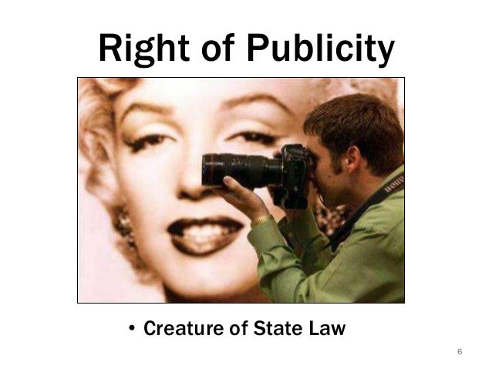
Introduction to Publicity Rights
Main Points
Definition: Right of Publicity allows individuals to control the commercial use of their identity.
Key Elements: Includes name, likeness, image, voice, and other identifiable characteristics.
Entrepreneurial Relevance: Essential to avoid misuse of recognizable individuals in advertising and promotional content.

Slide 24
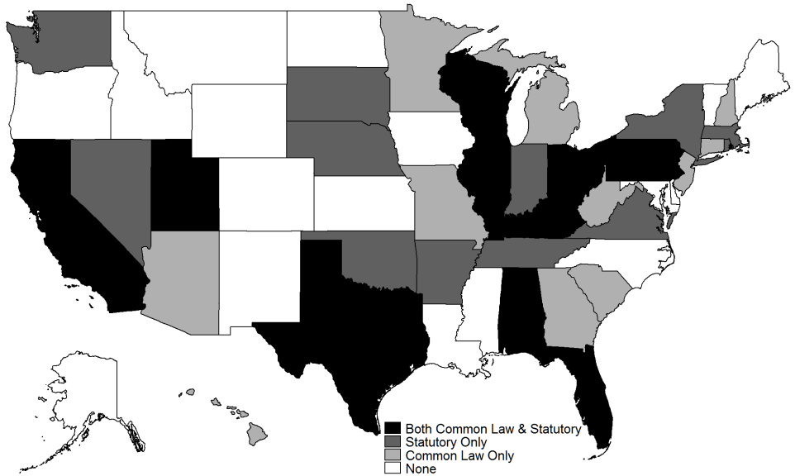
Legal Foundation of Right of Publicity
Federal vs. State: There are no federal rights of publicity; rights vary state by state.
Florida’s Approach: Florida protects publicity rights primarily under common law, focusing on privacy rights and misappropriation.
Covers personal identifiers, including name, image, and likeness.
In Florida, a broad interpretation applies, giving weight to potential endorsement implications.

Slide 25
Introduction to Publicity Rights
In Florida, the common law right of publicity, including the right not to have a person's name published without his or her consent, was first recognized as part of a right of privacy.
The common law right of publicity extends to any individual whose name or likeness has been exploited through unauthorized use during his or her lifetime.
Common law right of publicity recognizes exceptions for news reporting and for authorized publishers and distributors of a work to use an individual's name to truthfully identify the work's creator

Slide 26
Practical Implications of Publicity Rights
Importance of Licensing: For any recognizable person used in marketing, businesses should obtain written consent, ideally in the form of a license.
Risks of Misappropriation:
Unauthorized use of a person’s likeness can lead to legal claims for damages, injunctions, and sometimes punitive damages.
Highlight potential for reputational damage and negative press.
Examples:
Non-Celebrity Employees: Even employees can have a claim if their image implies endorsement without permission.

Slide 27
Practical Implications of Publicity Rights
Examples (Continued):
Celebrity Look-Alikes: Cases like Vanna White v. Samsung show the dangers of using look-alikes.

Slide 28
In The News
Parkland survivor wins ownership of shooter's name in lawsuit settlement: Anthony Borges, has obtained legal control over the name and likeness of Nikolas Cruz through a settlement agreement.
Implications: This transfer of rights prevents Cruz from exploiting his name for financial or personal gain.
Terms of Agreement: Cruz cannot profit from any movies, TV shows, or books without Borges' explicit permission.
Attorney’s Statement: “We just wanted to shut him down so we never have to hear about him again,” stated Alex Arreaza, attorney for Borges.
Anthony Borges

Slide 29
Practical Implications of Publicity Rights
Incidental Use: Limited use of someone’s likeness in a non-prominent, incidental role typically doesn’t require permission.
Newsworthiness: Use in news reporting or satire may qualify as exceptions, but must be approached carefully in Florida’s context.
Consent for Minors: Use of a minor’s likeness always requires parental consent, regardless of incidental usage.

Slide 30
Tips for Managing Right of Publicity and Transfer of Ownership
Obtain Explicit, Written Consent
Tip: Always secure a signed media release or licensing agreement before using anyone’s likeness, voice, or personal characteristics.
Best Practices: Ensure the agreement is comprehensive, covering scope, duration, territory, and specific permissions for any adaptations (like editing or repurposing content).

Slide 31
Tips for Managing Right of Publicity and Transfer of Ownership
Consider Scope and Duration Carefully
Usage Limitations: Limit the scope to what’s needed to avoid overextending rights or future disputes.
Duration Clauses: Specify whether rights are temporary or perpetual and note any territorial restrictions (like U.S. only or worldwide).
Renewal and Termination: Include clauses for renewal or termination in case of changes in business needs or individual withdrawal.

Slide 32
Tips for Managing Right of Publicity and Transfer of Ownership
Be Cautious with Look-Alikes and Sound-Alikes
Tip: If using look-alikes or sound-alikes, avoid exact replication and make it clear the individual isn’t endorsing the product directly.
Example: Avoid using famous catchphrases, gestures, or mannerisms closely associated with a specific individual.

Slide 33
Tips for Managing Right of Publicity and Transfer of Ownership
Understand Transfer and Assignment of Publicity Rights
In Life: Publicity rights are generally non-transferable unless expressly assigned via contract. This allows individuals to retain control.
Posthumous Rights: In Florida, publicity rights are not recognized for deceased individuals. However, some states (like California) allow posthumous publicity rights for a certain number of years, so national campaigns need to account for these differences.
Best Practice: For national campaigns, research each state’s laws regarding publicity rights and posthumous rights to avoid legal exposure.

Slide 34
Tips for Managing Right of Publicity and Transfer of Ownership
Handling Publicity Rights in Acquisitions or Mergers
Due Diligence: If acquiring a company or its assets, verify whether any publicity rights are transferable and if current permissions exist for any individual likenesses used in marketing.
Audit Rights Agreements: Review all licensing and consent agreements as part of the acquisition process to ensure they allow for continued use by the new business entity.

